Slide 1
EcoLogic
Smart. Sustainable. Affordable
MD. ABU TOWSIF
22-47019-1
SL # 02
ENGINEERING ETHICS
SECTION G

Slide 2
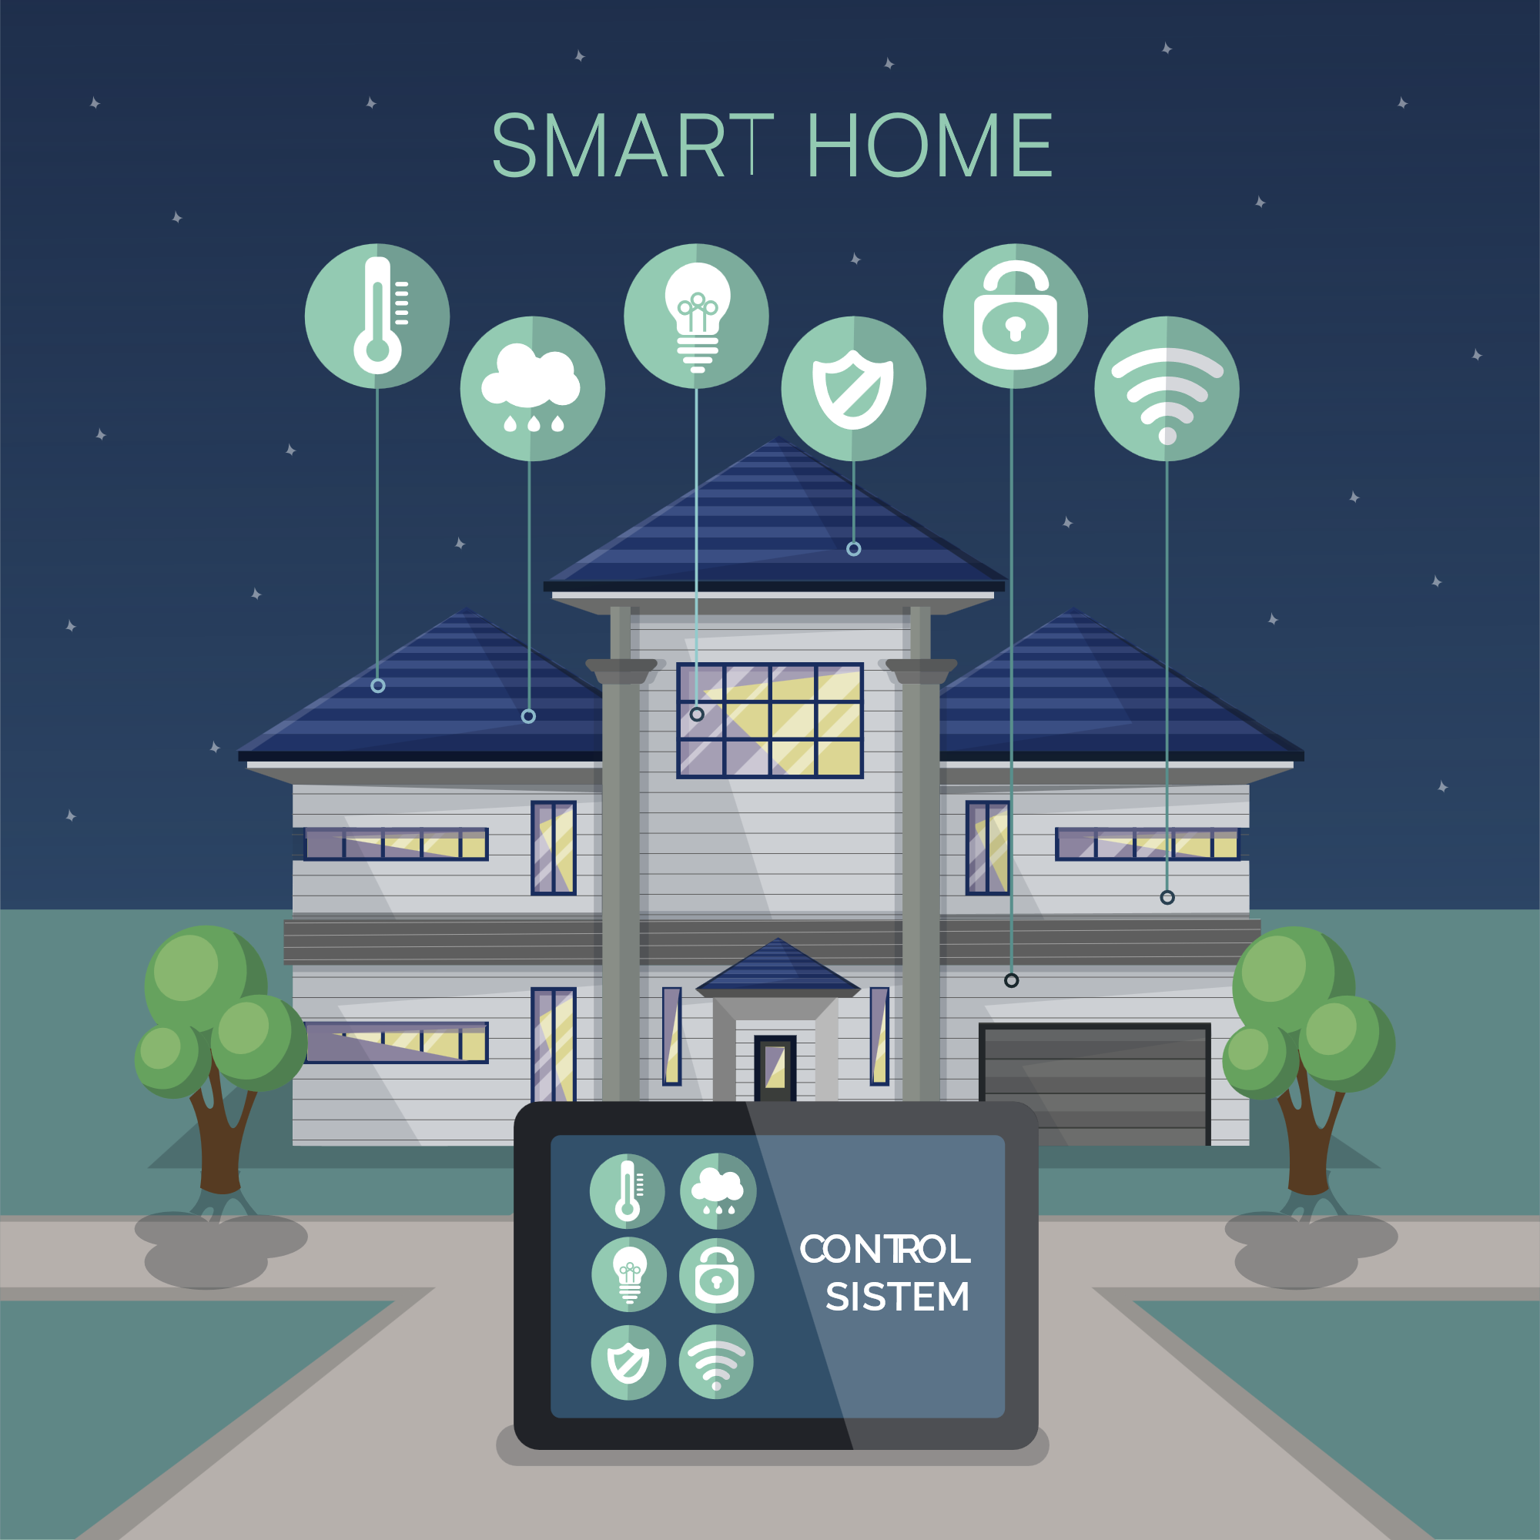

EcoLogic
The Introduction
Smart. Sustainable. Affordable
MD. ABU TOWSIF
22-47019-1
SL # 02
ENGINEERING ETHICS
SECTION G

Slide 3



EcoLogic
The Introduction
International Company
Vision
Empowering individuals and businesses with accessible software solutions that promote sustainable living and efficient smart energy
management

Slide 4
EcoLogic
The Introduction
Purpose
To bridge the digital and sustainability divides by providing affordable software platforms that empower energy-efficient, eco-friendly, and smart home automation solutions, enhancing the quality of life for individuals and businesses.

Slide 5


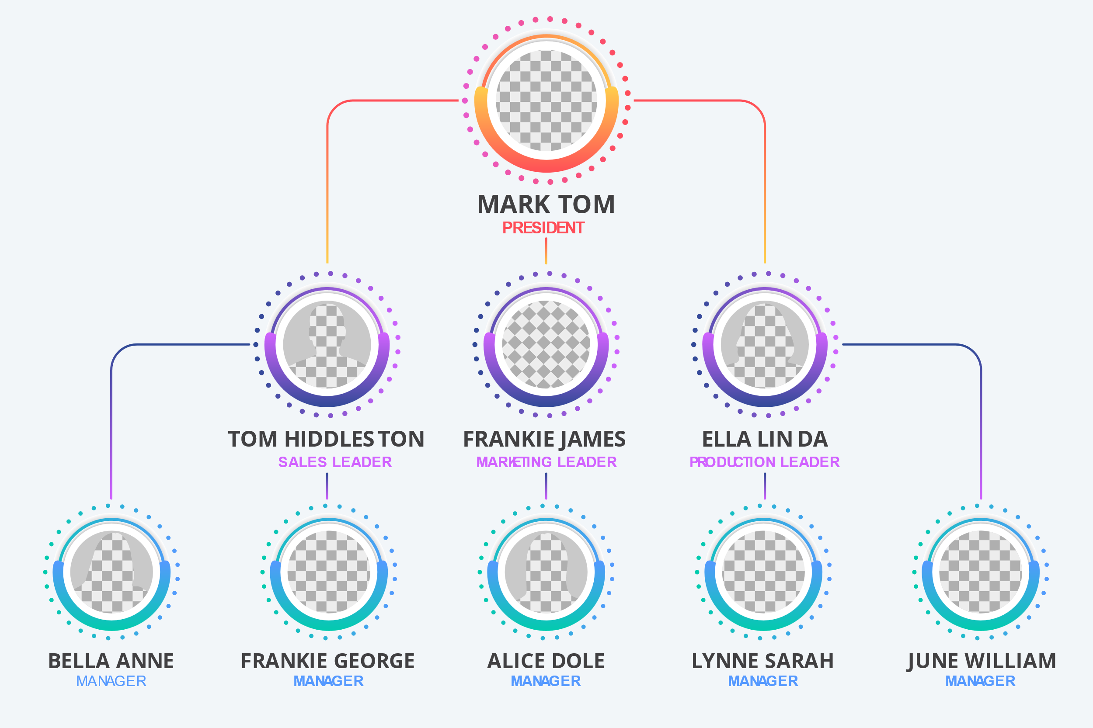





The Organizational structure
EcoLogic
Safety
Ensures the well-being of society
Fairness Ensures equal opportunities and treatment
Trust
Builds credibility and public confidence
Compliance
Adheres to legal and regulatory standards
chart
Sustainability
Promotes eco-friendly practices
Innovation
Fosters ethical problem-solving and creativity
Accountability
Upholds responsibility for actions

Slide 6
Importance of Ethics in Engineering
EcoLogic
Safety
Ensures the well-being of society
Fairness Ensures equal opportunities and treatment
Trust
Builds credibility and public confidence
Compliance
Adheres to legal and regulatory standards
Sustainability
Promotes eco-friendly practices
Innovation
Fosters ethical problem-solving and creativity
Accountability
Upholds responsibility for actions

Slide 7





Ethical Guidelines
EcoLogic
Ethical Behavior
Conflict of Interest and Gifts
Honesty, Integrity, Transparency
Sustainability Commitment
Disclosure of Conflicts
Gift Restrictions
Positive Work Environment
Proprietary Information and Compliance
Respect, Inclusivity
Collaboration, Work-life Balance
Information Protection
Intellectual Property Compliance
Records and Legal Compliance
Accurate Records
Legal Adherence

Slide 8




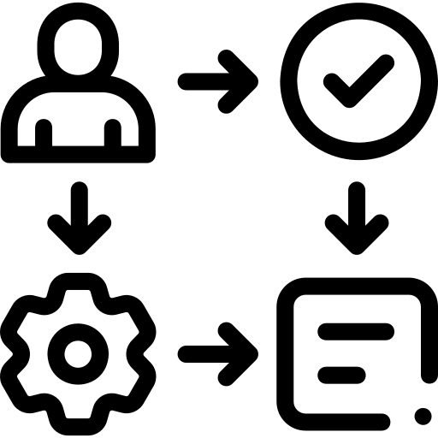





Implementation
EcoLogic
Enforcement
Monitoring
Regular Audits, Feedback
Investigation Incident Reporting, Fact-Finding
Training
Regular Ethics Training
Support Open Dialogue, Ethical Resources
Compliance
Performance Reviews
Communication
Clear Guidelines, Employee Handbook
Leadership
Ethical Role Models
Accountability
Transparency, Documentation
Disciplinary Actions
Warnings, Suspension, Termination
Onboarding
Ethical Induction

Slide 9
Implementation
EcoLogic
Enforcement
Training
Regular Ethics Training
Support Open Dialogue, Ethical Resources
Monitoring
Regular Audits, Feedback
Investigation Incident Reporting, Fact-Finding
Communication
Clear Guidelines, Employee Handbook
Leadership
Ethical Role Models
Compliance
Performance Reviews
Accountability
Transparency, Documentation
Onboarding
Ethical Induction
Disciplinary Actions
Warnings, Suspension, Termination

Slide 10





EcoLogic
Call to Action
Let’s all commit to maintaining integrity in every
aspect of our work, fostering a culture of transparency,
respect, and responsibility to achieve our shared vision

Slide 11











EcoLogic
Conclusion
Affordable Solutions
Ethical Guidelines
Sustainable Software
Maintaining Trust
Energy Management
Ensuring Fairness
Smart Home Automation
Driving Success
Quality of Life
Environmental Responsibility

Slide 12
Any
Question

